Slide 1
University Model
By:
Mridul regmi
Manju sharma
Krishna namdev

Slide 2
Approach
To study the impact of course, faculty and department on student employment after graduation, three dashboards were built for each of these factors
Using the analytics presented in the dashboards, the university administrators can assess the magnitude of the impact of each of the factors(faculty, course and department) on student employment, and make changes accordingly to optimize factors such as starting salary, promotion time, etc.

Slide 3
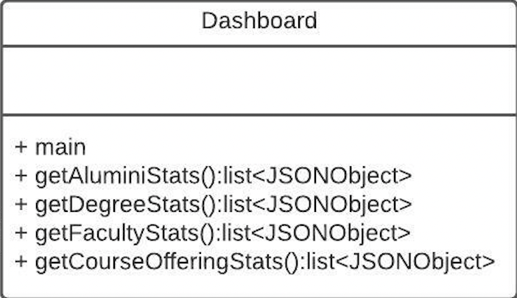
The Dashboard Class
Contains the main class
Fetches metrics and passes them to the frontend to be displayed in the dashboard

Slide 4
Getting Alumini Stats
getAluminiStats() method:
Public class, returns a JSON object containing the post-graduation metrics for each alumini. The metrics include:
Starting salary
Average promotion time(if applicable)
Position
Ranking of employer(From sources such as Fortune)

Slide 5
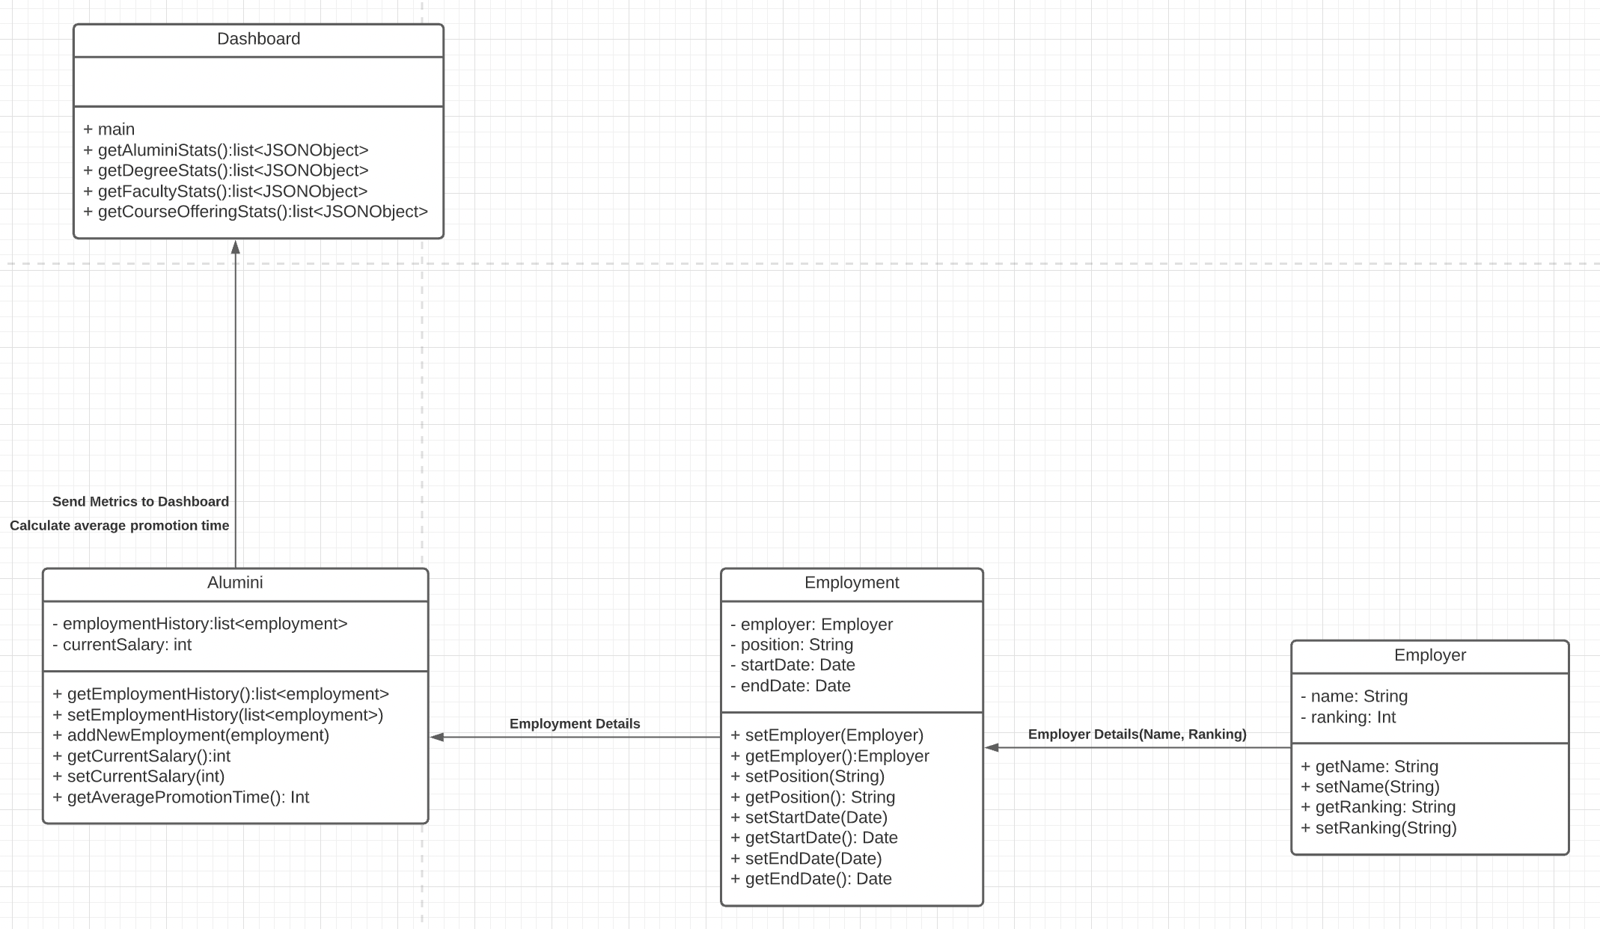
Getting Alumini Stats: Flow

Slide 6
Getting Alumini Stats: Pseudo Code
public List<JSONObject> getAluminiStats(){
ArrayList<Student> studentList=this.university.getStudentDirectory();
ArrayList<Alumini> aluminiList=new ArrayList<>();
studentList.forEach(student->aluminiList.add(student))
ArrayList<JSONObject> aluminiJSONList = new ArrayList<>();
for(Alumini alumini: aluminiList){
JSONObject aluminiJSON = new JSONObject();
ArrayList<String> employmentHistory = new ArrayList<>();
aluminiJSON.put("Current Salary",alumini.getCurrentSalary());
aluminiJSON.put("Average Promotion Time", alumini.getAveragePromotionTime());
aluminiJSON.put("Position", alumini.getEmploymentHistory[0].getPosition());
aluminiJSON.put("Employment History",alumini.getEmploymentHistory.forEach(employment->employmentHistory.add(employment.getEmployer.getName())));
aluminiJSON.put("Employer Ranking", alumini.getEmploymentHistory[0].getEmployer.getRanking());
aluminiJSON.put("GPA", alumini.getGPA())
aluminiJSONList.add(aluminiJSON);
}
return aluminiJSONList;
}

Slide 7
Getting Degree Stats
getDegreeStats() method:
Public class, returns a JSON object containing the post-graduation metrics for students belonging to the particular degree. The metrics include:
Average starting salary
Average promotion time(if applicable)
Average ranking of the companies the students are working for

Slide 8
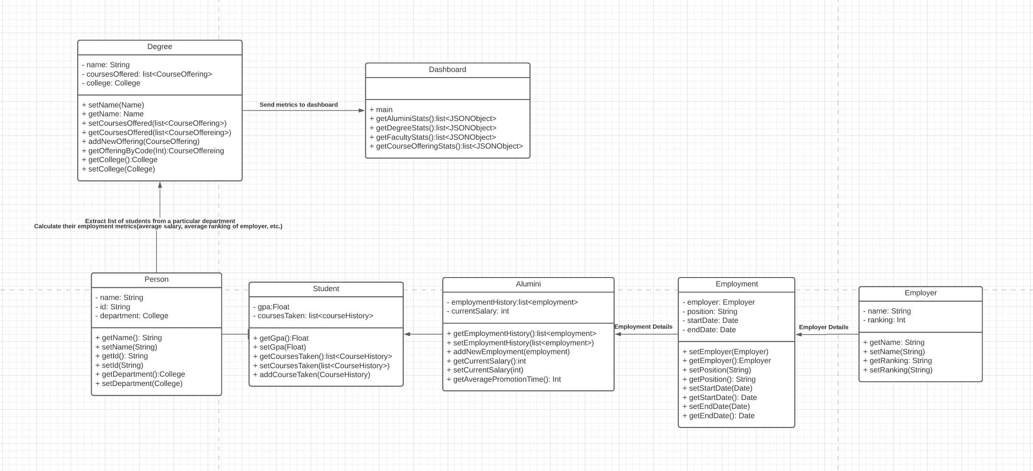
Getting Degree Stats: Flow

Slide 9
Getting Degree Stats: Pseudo Code
public List<JSONObject> getDegreeStats(){
ArrayList<College> collegeList=this.university.getColleges();
ArrayList<Degree> degreeList=new ArrayList<>();
collegeList.forEach(college->degreeList.add(college.getDegreesOffered()));
ArrayList<JSONObject> degreeJSONList = new ArrayList<>();
for(Degree degree: degreeList){
JSONObject degreeJSON = new JSONObject();
ArrayList<String> employmentHistory = new ArrayList<>();
ArrayList<Alumini> aluminiList = dao.getAluminiByDegree(Degree degree);
int grossSalary, grossGPA, grossEmployerRanking= 0;
for(Alumini alumini: aluminiList){
grossSalary += alumnini.getCurrentSalary();
grossGPA += alumini.getGpa();
grossEmployerRanking+=alumini.getEmploymentHistory.getEmployer.getRanking();
}
degreeJSON.put("Average Salary",grossSalary/aluminiList.length());
degreeJSON.put("Average Ranking",grossESalary/aluminiList.length());
degreeJSON.put("Average GPA",grossGPA/aluminiList.length());
degreeJSONList.add(degreeJSON);
}
return degreeJSONList;
}

Slide 10
Getting Faculty Stats
getFacultyStats() method:
Public class, returns a JSON object containing the post-graduation metrics for students who were taught by a particular faculty. The metrics include:
Average starting salary
Average promotion time(if applicable)
Average ranking of the companies the students are working for

Slide 11
Getting Faculty Stats: Process
The course offerings associated with the faculty is extracted
The list of students who have taken the list is extracted
The stats of the students is extracted, aggregated and sent to the dashboard

Slide 12
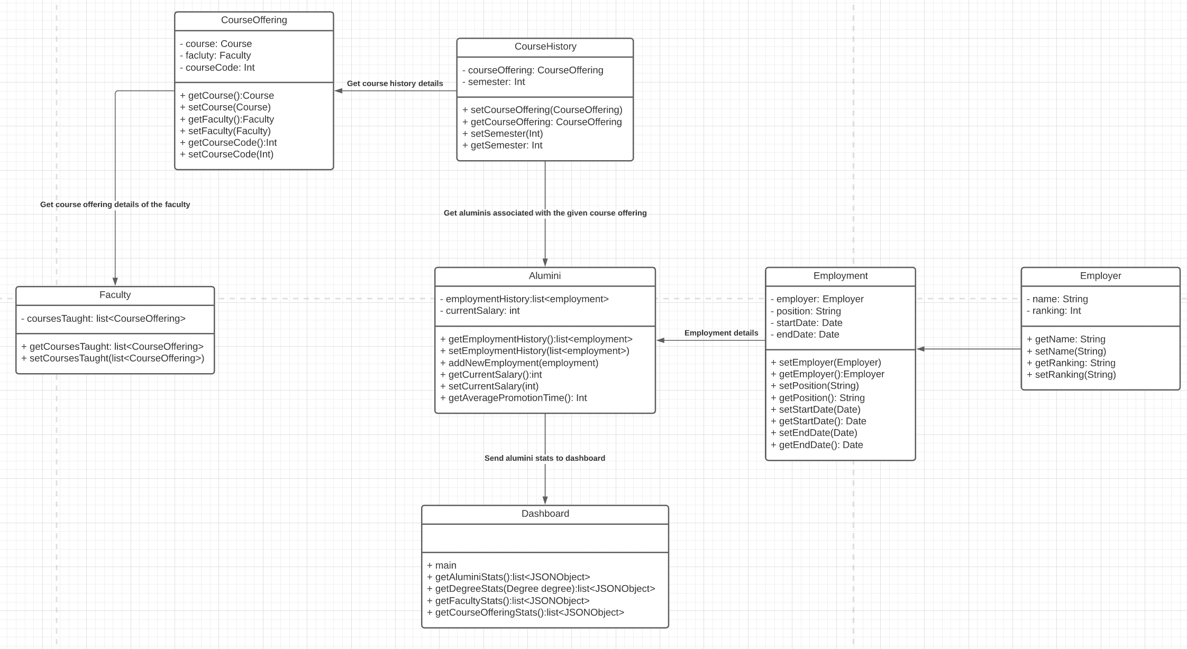
Getting Faculty Stats: Flow

Slide 13
Getting Faculty Stats: Pseudo Code
public List<JSONObject> getFacultyStats(){
ArrayList<Faculty> facultyList=this.university.getFacultyDirectory();
ArrayList<JSONObject> facultyJSONList = new ArrayList<>();
for(Faculty faculty: facultyList){
JSONObject facultyJSON = new JSONObject();
facultyJSON.put("Faculty", faculty.getName());
ArrayList<CourseOffering> coursesTaught = faculty.getCoursesTaught();
ArrayList<Alumini> aluminiForOfferings = new ArrayList<>();
for(CourseOffering courseOffering: coursesTaught){
aluminiForOfferings.add(dao.getAluminiByOffering());
}
for(Alumini alumini: aluminiForOfferings){
grossSalary += alumnini.getCurrentSalary();
grossGPA += alumini.getGpa();
grossEmployerRanking+=alumini.getEmploymentHistory.getEmployer.getRanking();
}
facultyJSON.put("Average Salary",grossSalary/aluminiList.length());
facultyJSON.put("Average Ranking",grossESalary/aluminiList.length());
facultyJSON.put("Average GPA",grossGPA/aluminiList.length());
facultyJSONList.add(facultyJSON);
}
return facultyJSONList;
}

Slide 14
Getting Course Stats
getCourseOfferingStats():
Public class, returns a JSON object containing the post-graduation metrics for students who took a particular course offering. The metrics include:
Average GPA
Average starting salary
Average promotion time(if applicable)
Average ranking of the companies the students are working for

Slide 15
Getting Course Stats: Process
The list of course offerings is extracted
The list of students who have taken the list is extracted
The stats of the students is extracted, aggregated and sent to the dashboard

Slide 16
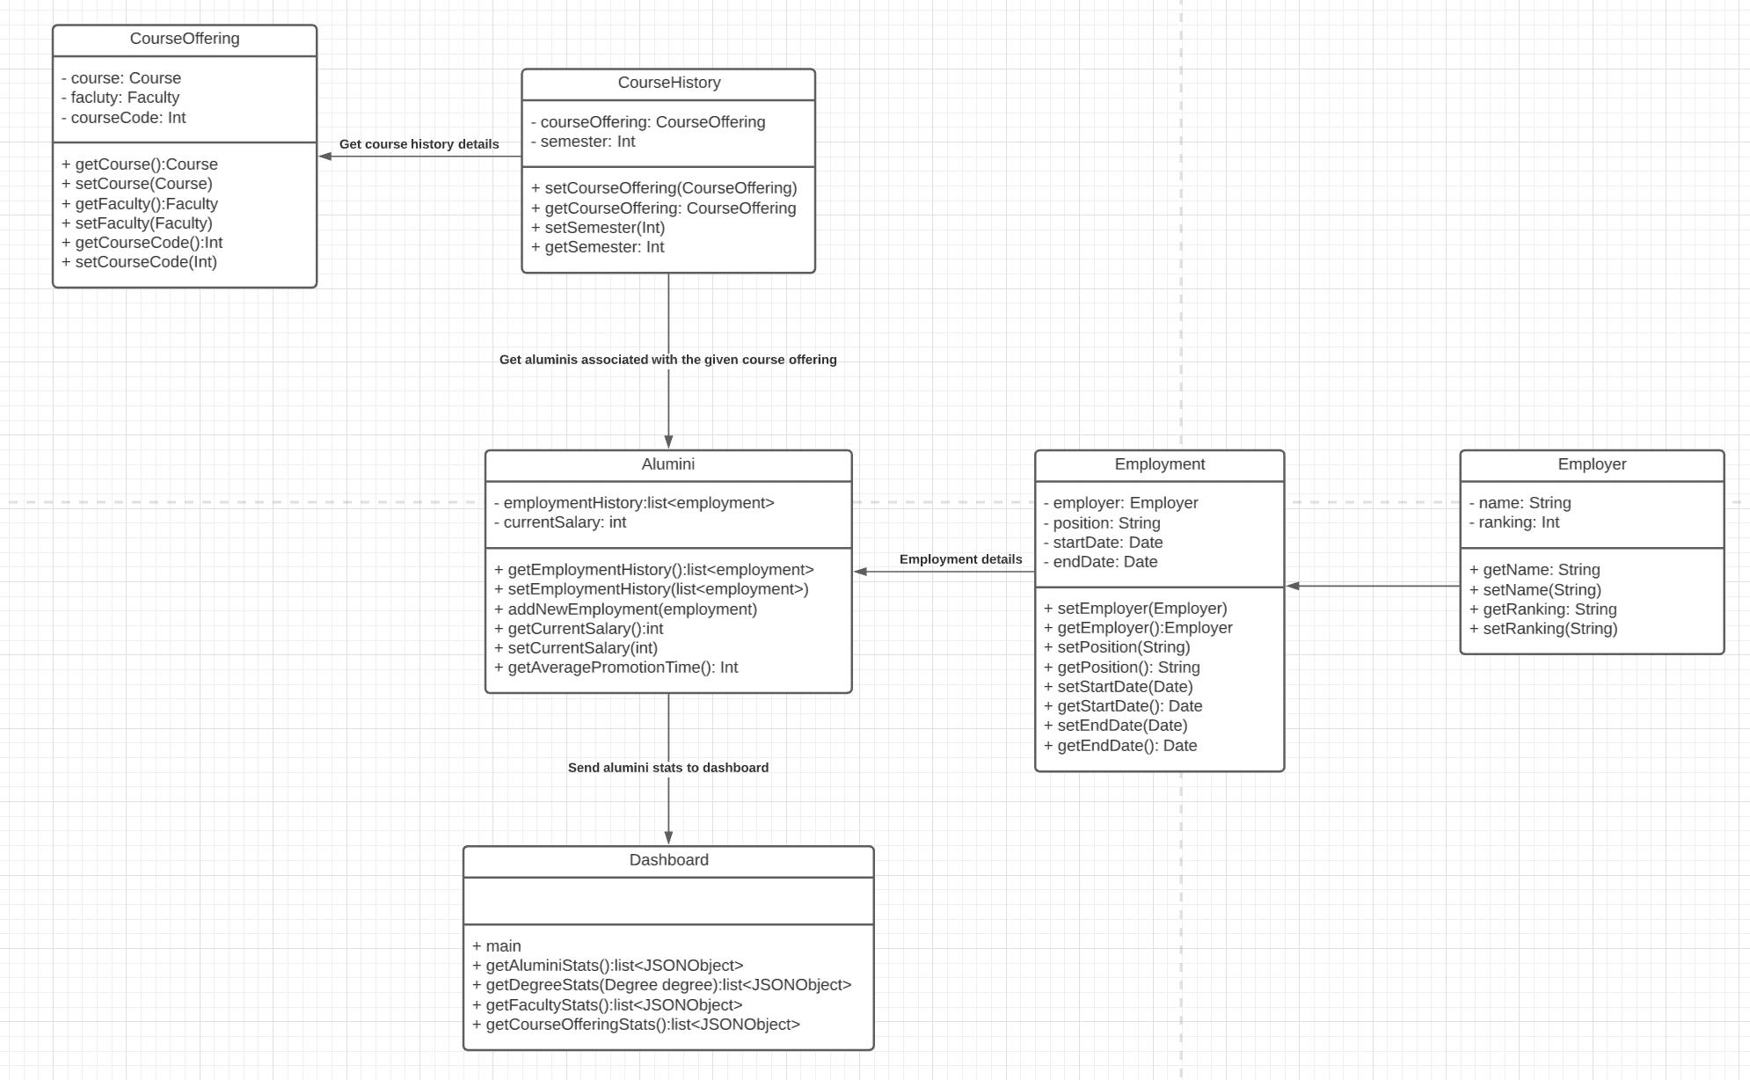
Getting Course Stats: Flow

Slide 17
Getting Course Stats: Pseudo Code
public List<JSONObject> getCourseStats(){
ArrayList<Colleges> colleges = this.university.getCollegs.getCoursesTaught();
ArrayList<CourseOfferings> courseOfferings = new ArrayList<>();
colleges.forEach(college->courseOfferings.add(college.getCoursesOffered()));
ArrayList<Alumini> aluminiForOffering=new ArrayList<>();
ArrayList<JSONObject> courseJSONList = new ArrayList<>();
for(CourseOffering courseOffering: courseOfferings){
JSONObject courseJSON = new JSONObject();
aluminiForOfferings=dao.getAluminiByOffering(courseOffering);
for(Alumini alumini: aluminiForOfferings){
grossSalary += alumnini.getCurrentSalary();
grossGPA += alumini.getGpa();
grossEmployerRanking+=alumini.getEmploymentHistory.getEmployer.getRanking(); }
courseJSON.put("Average Salary",grossSalary/aluminiList.length());
courseJSON.put("Average Ranking",grossESalary/aluminiList.length());
courseJSON.put("Average GPA",grossGPA/aluminiList.length());
courseJSONList.add(degreeJSON);}
return courseJSONList;}

